Slide 1
Marriage proposal
CAPSTONE PROJECT
Presented By:
Naveen M
9513- Jayaraj Annapackiam CSI College of Engineering
B.E Mechanical Engineering

Slide 2
OUTLINE
Problem Statement
Proposed System/Solution
System Development Approach
Algorithm & Deployment
Result
Conclusion
Future Scope
References

Slide 3
Problem Statement
Design and implement a memorable and personalized marriage proposal experience that reflects the unique relationship between [Name of proposer] and [Name of partner]. The proposal should incorporate creative elements, meaningful gestures, and surprise elements to create a memorable moment. The proposal should be well-planned, considerate of the partner's preferences and personality, and aim to create a cherished memory for both individuals

Slide 4
Proposed Solution
Know Your Partner: Understand your partner's preferences, interests, and personality traits. Consider what they find romantic, meaningful, and memorable.
Choose a Meaningful Location: Select a location that holds significance for both of you, such as where you first met, had a memorable date, or shared a special moment.
Plan the Timing: Choose a date and time that will be convenient and conducive to a romantic atmosphere. Consider factors like weather, crowd levels, and privacy.
Create a Personalized Touch: Incorporate elements that reflect your relationship, such as inside jokes, shared memories, or sentimental items. This could include personalized gifts, handwritten notes, or a slideshow of memorable moments.
Plan a Surprise Element: Add a surprise element to the proposal to make it memorable. This could be a flash mob, surprise guests, or a special performance.
Capture the Moment: Arrange for someone to capture the proposal on camera or video to preserve the memory. Hiring a professional photographer or videographer can ensure high-quality footage.
Choose the Right Ring: If you're planning to propose with a ring, choose a ring that suits your partner's style and preferences. Consider their ring size and any specific design preferences they may have.
Practice Your Proposal: Rehearse your proposal speech or plan your words ahead of time to ensure you convey your feelings and intentions clearly and confidently.
Consider After-Proposal Plans: Plan something special for after the proposal, such as a romantic dinner, a weekend getaway, or a celebration with family and friends.

Slide 5
System Approach
Creating a marriage proposal system involves a thoughtful approach that considers the preferences, personalities, and dynamics of the couple involved. Here's a structured system approach to planning a successful marriage proposal:
Step 1: Understand the Couple
Gather Information: Collect information about the couple's relationship, preferences, interests, and memorable moments together. This could include favorite activities, meaningful locations, shared hobbies, and romantic gestures.
Step 2: Define Proposal Goals
Set Objectives: Clarify the goals and objectives of the proposal. Determine the desired atmosphere, emotions to evoke, and the overall experience you want to create.
Step 3: Plan Proposal Elements
Select a Location: Choose a location that holds significance for the couple or resonates with their interests and preferences. Consider factors like privacy, ambiance, and accessibility.
Create a Theme: Develop a theme or concept for the proposal that reflects the couple's personalities and relationship dynamics. This could be based on shared interests, favorite movies, travel experiences, or cultural elements.
Incorporate Personalization: Add personalized elements to the proposal, such as custom decorations, meaningful symbols, personalized gifts, or sentimental touches.
Design Surprise Elements: Plan surprise elements that will delight and surprise the partner, such as unexpected guests, special performances, or hidden messages.

Slide 6
Algorithm & Deployment
Proposal Algorithm
Gather Information:
Collect information about the couple's relationship, interests, and preferences.
Identify meaningful locations, shared activities, and special memories.
Define Proposal Goals:
Determine the desired atmosphere, emotions, and experience for the proposal.
Set objectives such as surprise elements, personalization, and romantic ambiance.
Select Proposal Elements:
Choose a location that resonates with the couple and fits the proposal theme.
Incorporate personalization through customized decorations, gifts, or gestures.
Plan surprise elements like hidden messages, unexpected guests, or special performances.
Logistics and Coordination:
Coordinate logistical details such as date, time, permits, reservations, and transportation.
Engage collaborators such as event planners, decorators, musicians, photographers, and videographers.
Communicate with vendors, providing them with instructions and expectations.
Practice and Rehearse:
Rehearse any planned speeches, performances, or surprise elements to ensure smooth execution.
Conduct walkthroughs at the proposal location to familiarize with the setup and timing.

Slide 7
Development
Algorithm Development:
Develop the marriage proposal algorithm based on the structured approach outlined above.
Incorporate variables, decision points, and conditional branches to guide the proposal planning process.
Technology Integration:
Utilize technology tools such as planning apps, communication platforms, and project management software to streamline the proposal planning and coordination.
Implement automation features for reminders, notifications, and task assignments.
Collaborator Engagement:
Engage collaborators including event planners, decorators, musicians, photographers, and videographers.
Use collaborative platforms for communication, file sharing, and coordination among team members.
Testing and Validation:
Test the proposal algorithm in simulated scenarios to ensure functionality, accuracy, and feasibility.
Validate the algorithm's performance by executing real-world proposals and gathering feedback from couples and collaborators.
Deployment and Execution:
Deploy the proposal algorithm for actual marriage proposal planning and execution.

Slide 8
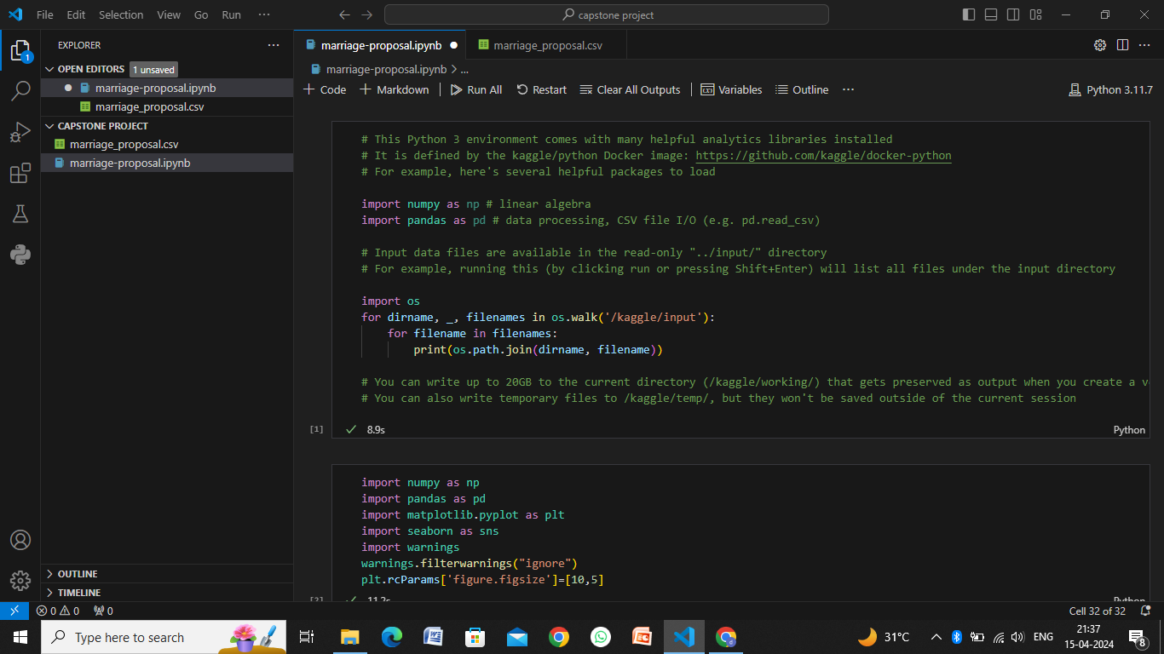
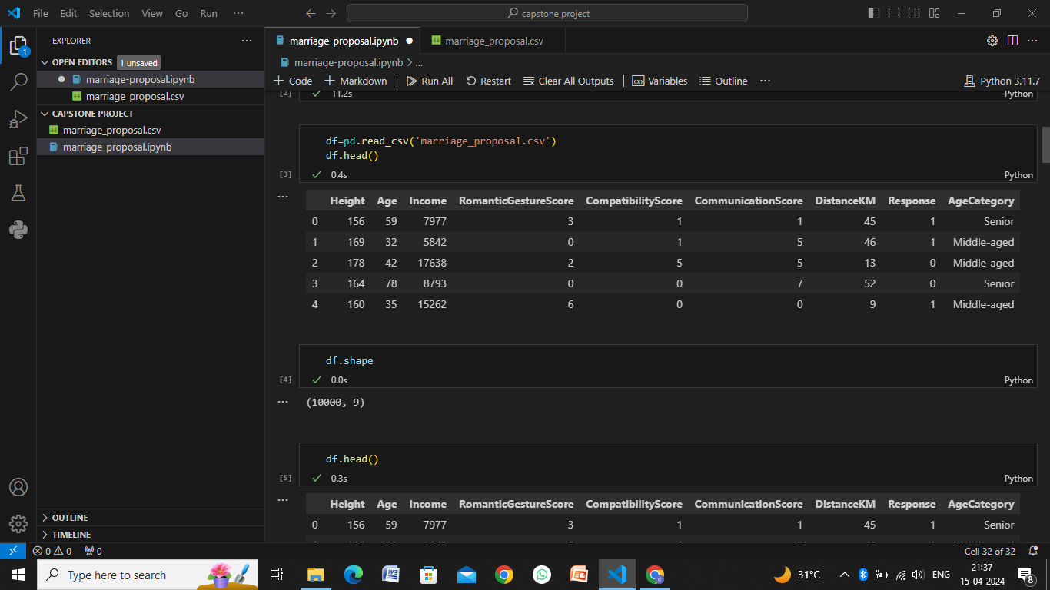
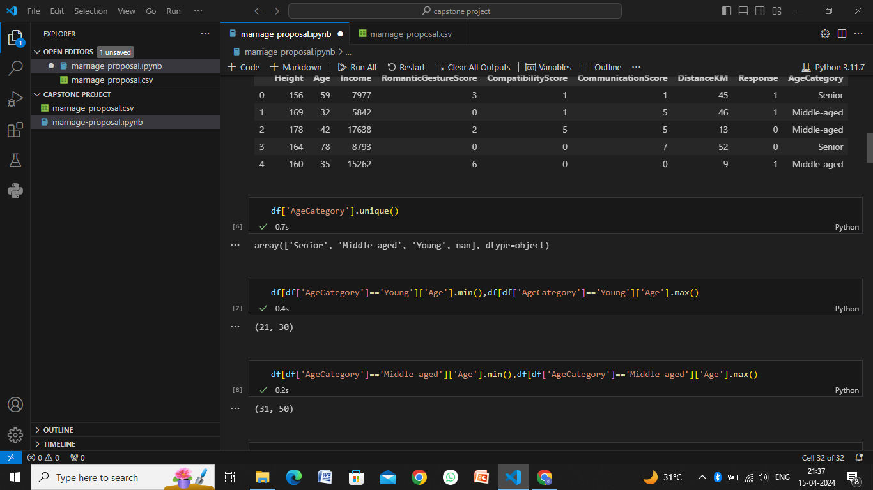
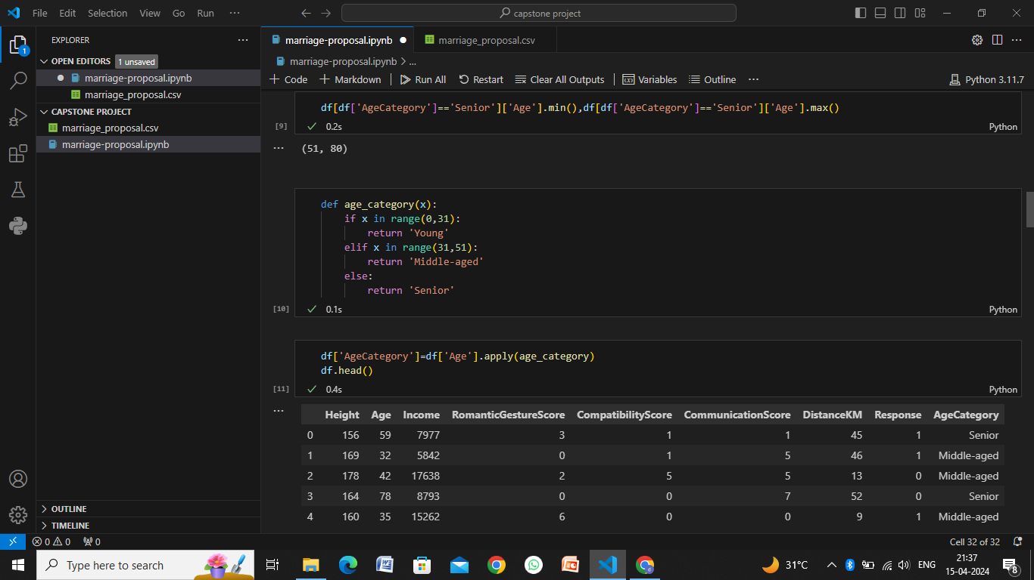
Result

Slide 9
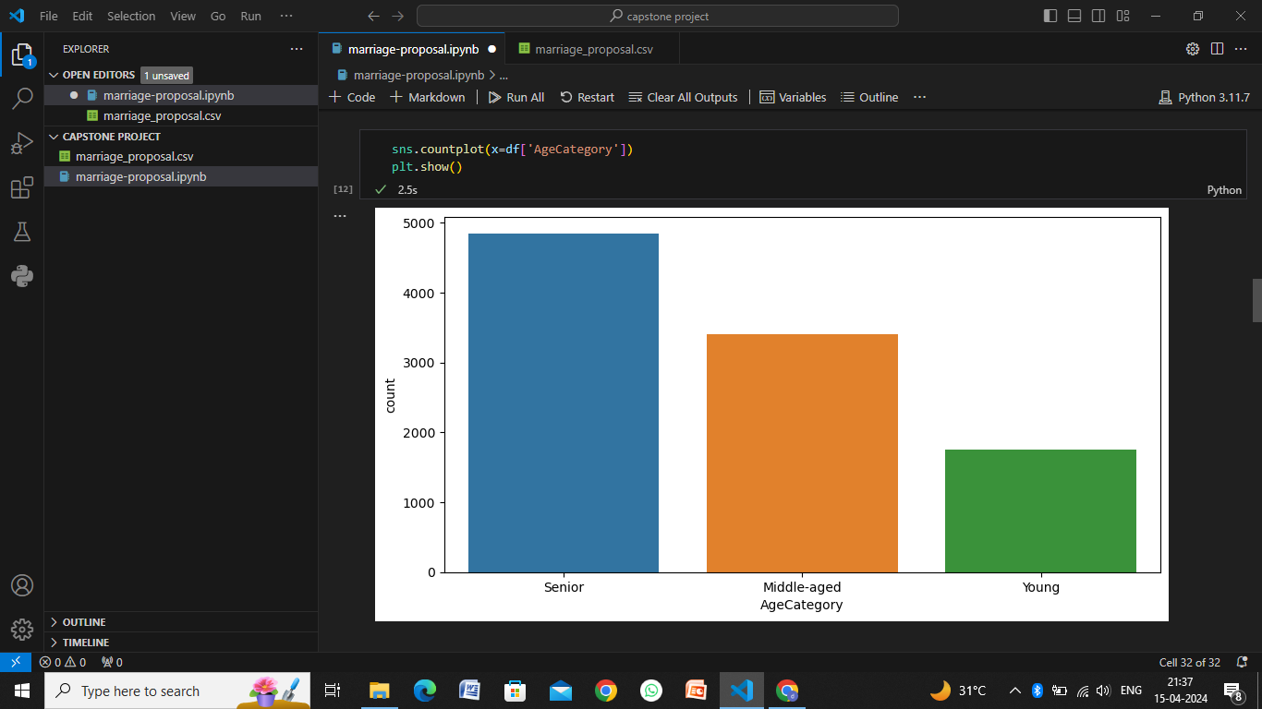
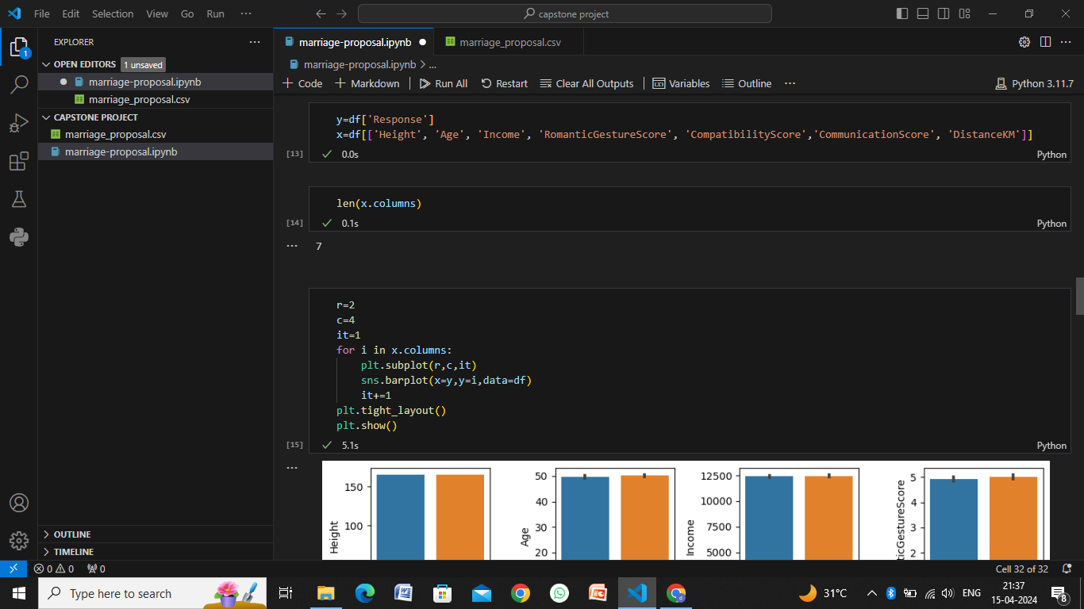
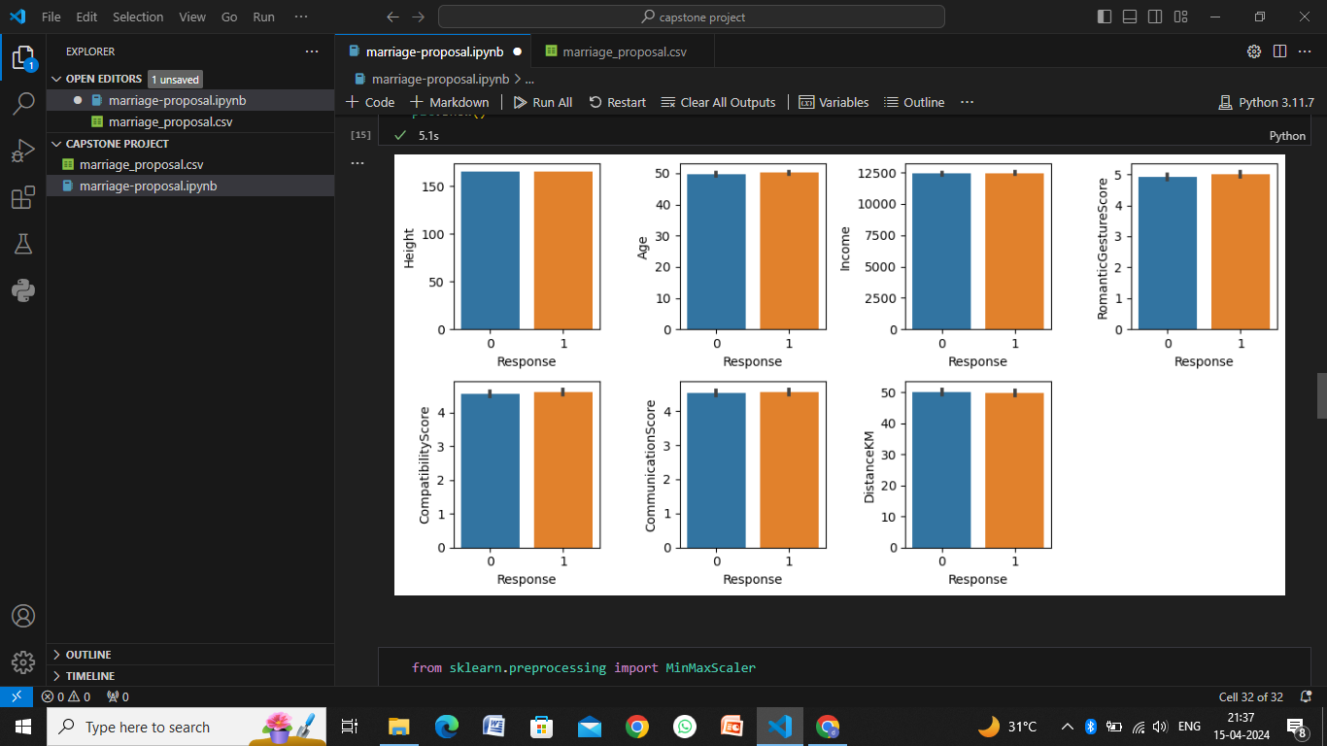
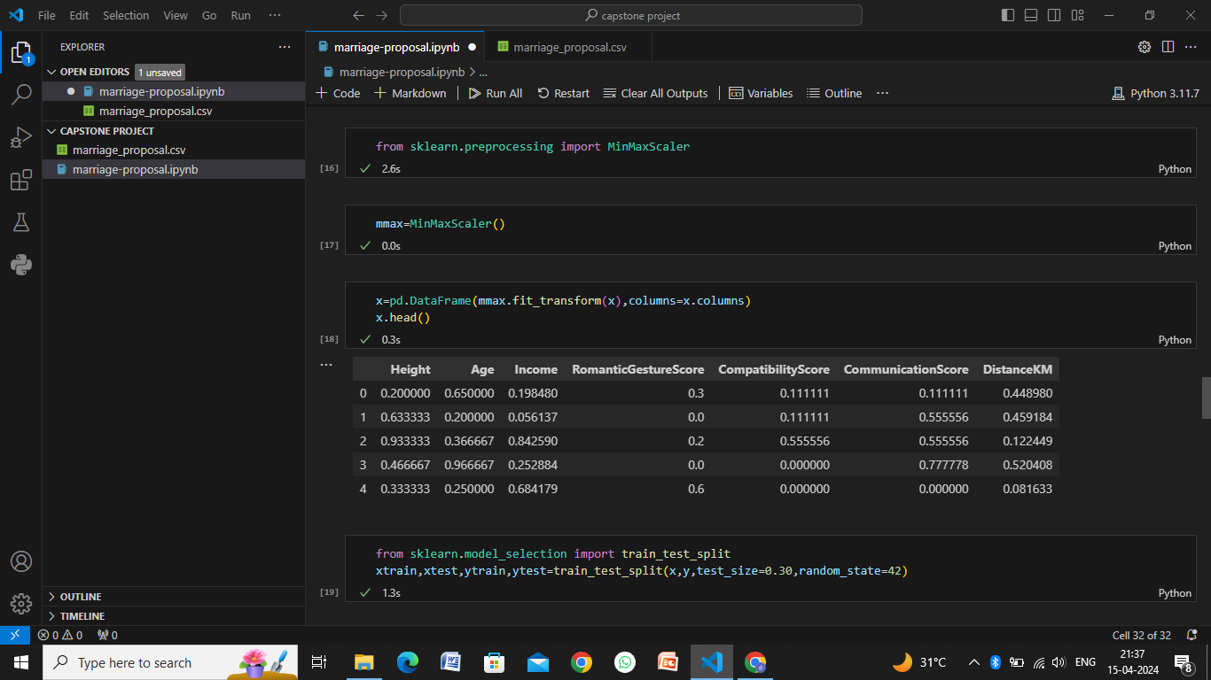

Slide 10
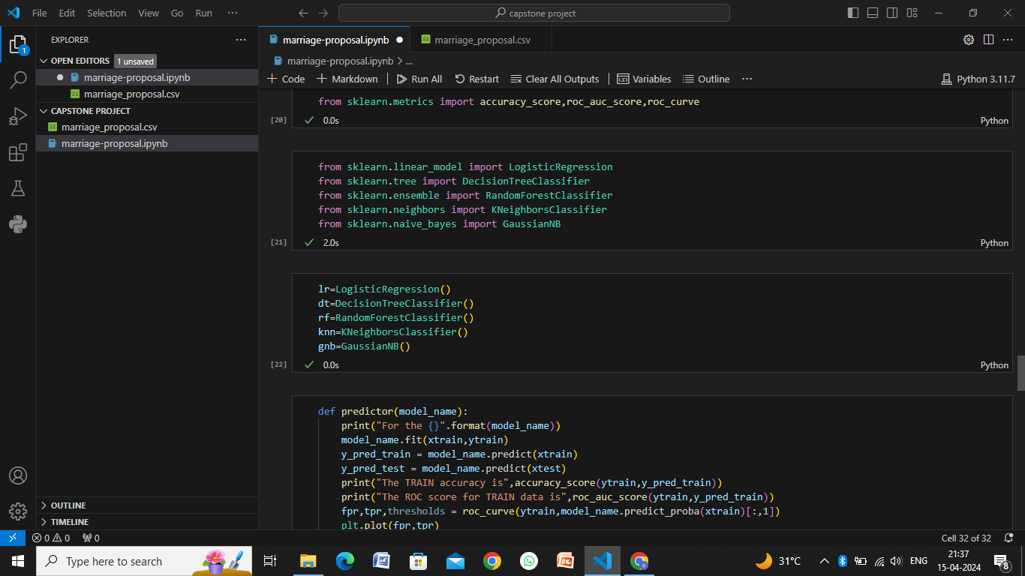
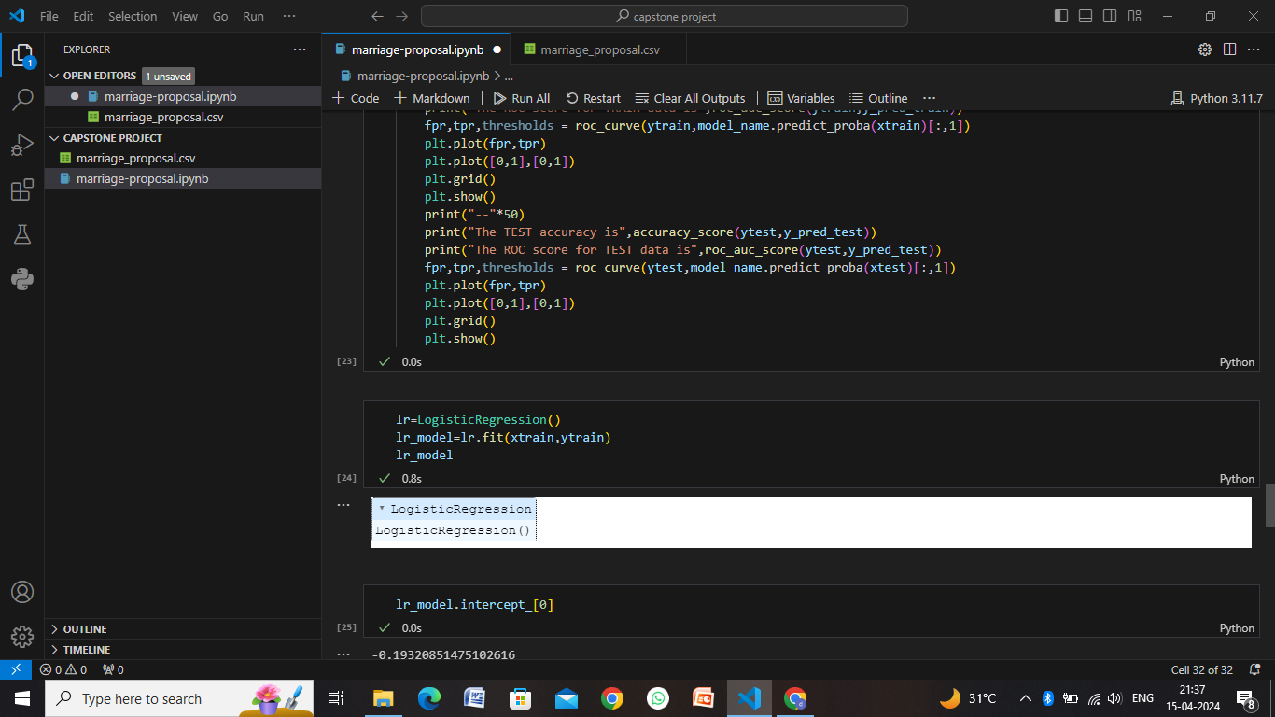
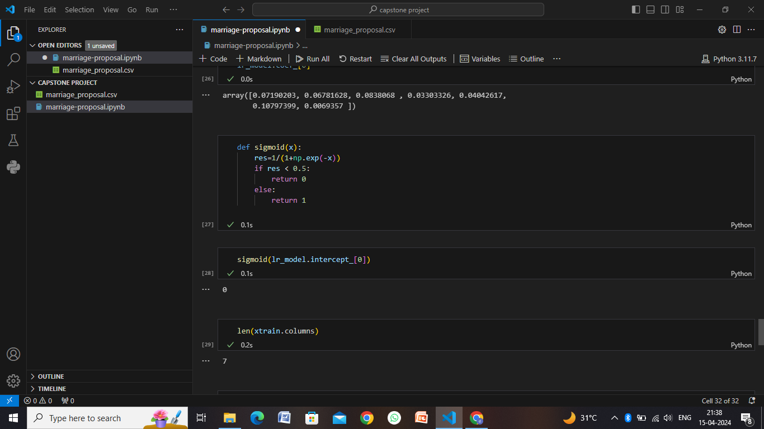
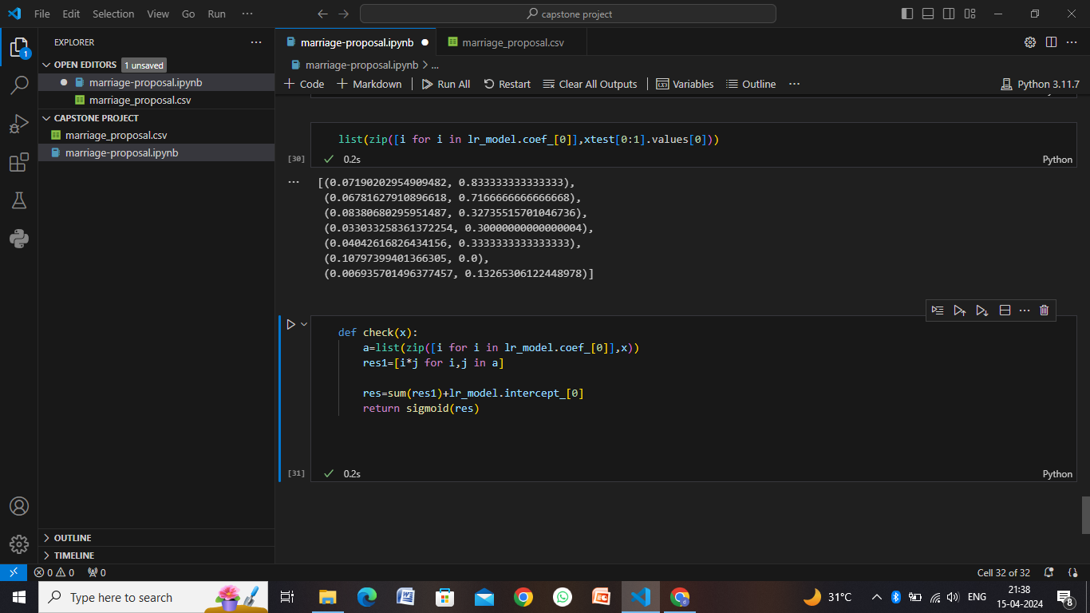

Slide 11
Conclusion
In conclusion, planning a marriage proposal is a deeply personal and meaningful endeavor that requires careful thought, creativity, and attention to detail. By following a structured approach, including gathering information about the couple, defining proposal goals, selecting personalized elements, coordinating logistics, practicing and rehearsing, executing the proposal, celebrating together, and reflecting on the experience, you can create a memorable and heartfelt moment that reflects the love and commitment between the couple.
It's essential to consider the preferences, interests, and personalities of both partners, as well as incorporating surprise elements, personalization, and thoughtful gestures to make the proposal special. Collaborating with vendors, event planners, decorators, musicians, photographers, and videographers can help bring your vision to life and ensure a smooth and magical experience.
Ultimately, the goal of a marriage proposal is to create a cherished memory that marks the beginning of a new chapter in the couple's life journey together. By putting effort into planning, communication, and execution, you can create a proposal that captures the essence of your relationship and sets the stage for a beautiful future together.

Slide 12
Future scope
The future scope of marriage proposals is evolving with advancements in technology, changing social norms, and personalized preferences. Here are some potential areas of growth and innovation in the realm of marriage proposals:
Virtual and Augmented Reality Experiences
Digital Proposal Platforms
Personalized AI Assistance
Interactive Proposal Collaborations
Environmental and Social Responsibility
Multicultural and Inclusive Proposals
Proposal Documentation and Sharing

Slide 13
References
Wedding Planning Websites: Websites dedicated to wedding planning often include sections or articles on marriage proposals. Examples include The Knot (https://www.theknot.com/), WeddingWire (https://www.weddingwire.com/), and Brides (https://www.brides.com/).
Social Media Platforms: Platforms like Pinterest and Instagram are rich sources of inspiration for marriage proposals. You can search for hashtags like #marriageproposal, #proposalideas, or #engagement to discover creative proposals and ideas shared by users.
YouTube: YouTube features countless videos of real marriage proposals, proposal planning tips, and proposal idea compilations. You can search for terms like "creative marriage proposals" or "best proposal ideas" to find inspiration.
Blogs and Online Magazines: Many blogs and online magazines related to relationships, weddings, and romance publish articles and stories about marriage proposals. Examples include HuffPost Weddings (https://www.huffpost.com/life/weddings) and The Spruce (https://www.thespruce.com/weddings-4127803).
Books and Guides: There are books and guides available that provide advice on planning memorable marriage proposals. Look for titles like "The Knot Book of Wedding Lists" or "How to Propose: 365 Ways to Pop the Question" for insights and ideas.

Slide 14
THANK YOU

